Slide 1
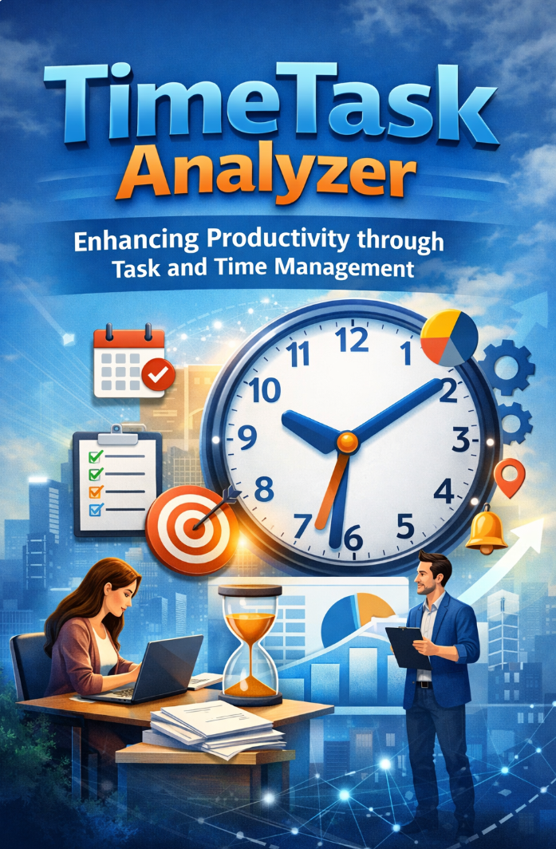
Time Task Analyzer
Enhancing Productivity through Task and Time Management
Zarish Shahzad

Slide 2
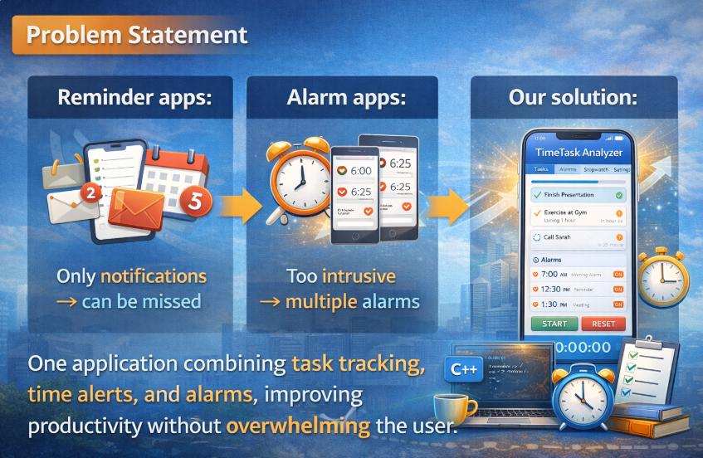
Problem Statement

Slide 3
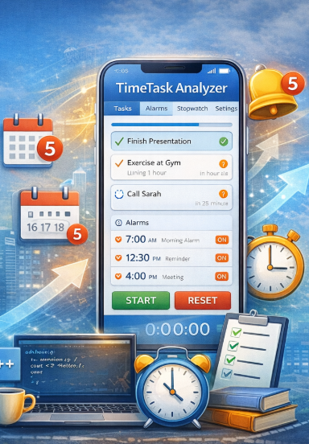
Introduction
Efficient task and time management is essential in today’s fast-paced life.
Traditional reminder apps either give notifications only or multiple intrusive alarms.
TimeTask Analyzer combines task tracking, alarms, and stopwatch features in one program.
Developed using C++ and fundamental programming concepts.

Slide 4
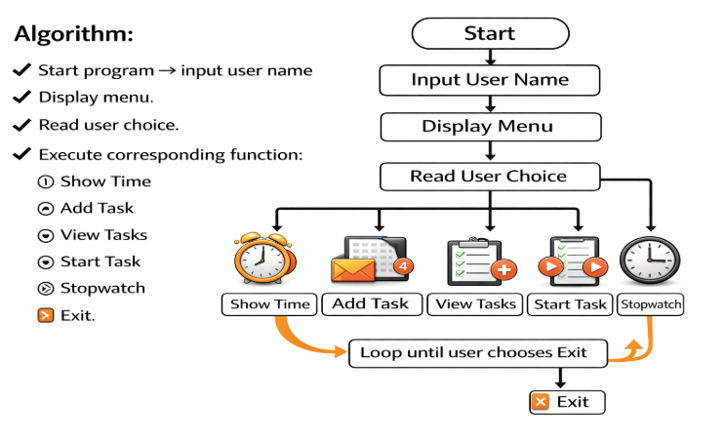

Slide 5
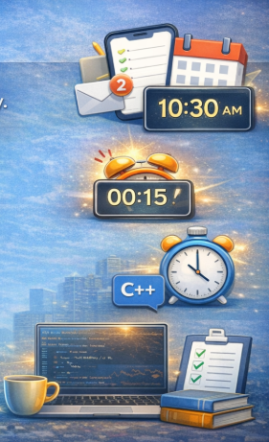
Objectives
Add, view, and manage tasks efficiently.
Display real-time current time.
Start tasks with countdown timers and trigger alarms. Provide stopwatch functionality: start, pause, resume, reset.
User-friendly, menu-driven program using C++ fundamentals

Slide 6
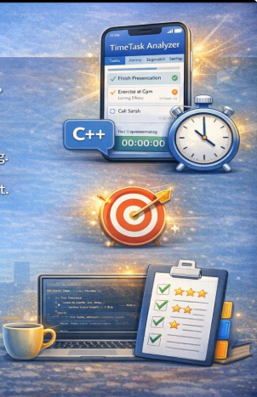
Analyzing Output and conclusion
TimeTask Analyzer combines task tracking, alarms, and stopwatch in a single program.
Implements C++ fundamentals: structures, arrays, loops, functions, and decision-making.
Improves productivity and time management.
Can be extended in future:
Task prioritization
GUI interface
Task categories
Questions and Discussion
Thank You!

